Slide 1
Auto-Encoding Variational Bayes
Diederik P Kingma, Max Welling
모바일시스템공학과
박찬호
Kingma, Diederik & Max Welling, Auto-encoding variational bayes, 2nd International Conference on Learning Representations. 2014

Slide 2
Contents
Before Getting Started
Bayesian
Generative Model
Maximum Likelihood Estimation
Entropy, Cross-Entropy
KL Divergence
Variational Inference
Auto-Encoder
Data Manifold
Variational Auto-Encoder
Loss Function
Optimization
Reparameterization Trick
Structure
Conclusion

Slide 3
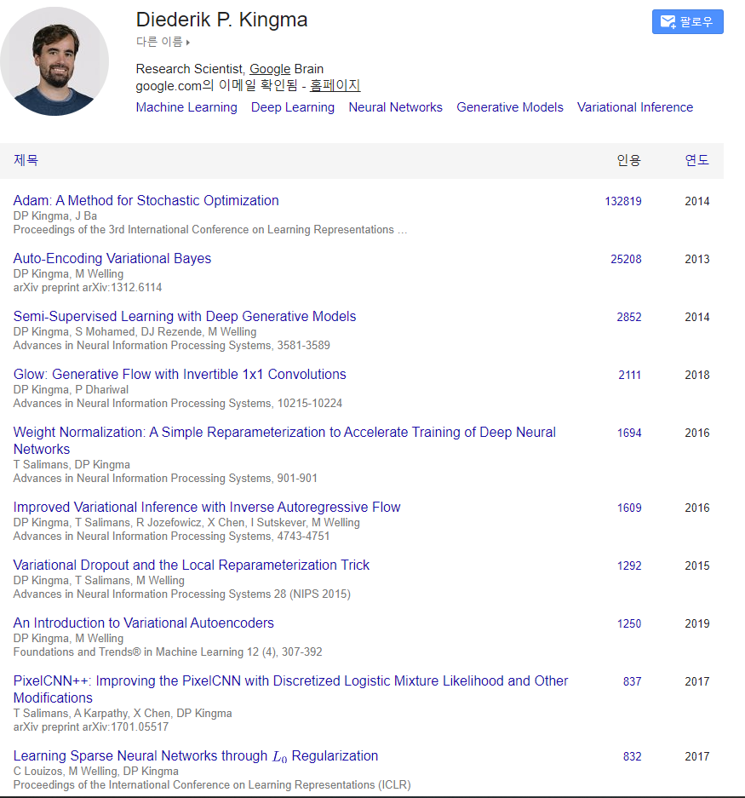
Before Getting Started
Diederik P Kingma, Max Welling
ICLR
2014
Generative Model

Slide 4
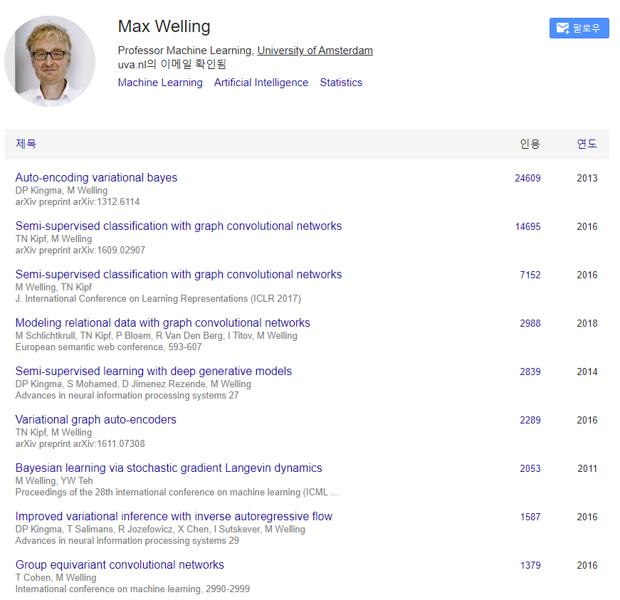
Before Getting Started
Diederik P Kingma, Max Welling
ICLR
2014
Generative Model

Slide 5
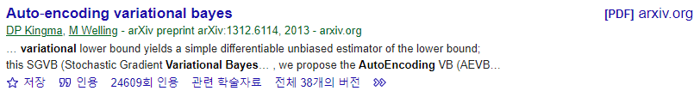
Before Getting Started
Diederik P Kingma, Max Welling
ICLR
2014
Generative Model

Slide 6
Before Getting Started
Generative Models Timeline
2014
2015
2016
2017
2018
2019
2020
2021
2022
VAE
Original GAN
PixelRNN
EBGAN
DDPM
DDIM
StyleGAN
Stable Diffusion
DCGAN
First Diffusion*
First Flow-based**
CycleGAN
DeepFakes
PixelCNN++
SAGAN
Diffusion Models Beat GANs on Image Synthesis
Latent Diffusion Models (Stable Diffusion)
* Jascha Sohl-Dickstein et al. Unsupervised Learning using Nonequilibrium Thermodynamics ** Danilo Jimenez Rezende; Mohamed, Shakir. Variational Inference with Normalizing Flows

Slide 7
Before Getting Started
Generative Models Timeline
2014
2015
2016
2017
2018
2019
2020
2021
2022
VAE
Original GAN
PixelRNN
EBGAN
DDPM
DDIM
StyleGAN
Stable Diffusion
DCGAN
First Diffusion*
First Flow-based**
CycleGAN
DeepFakes
PixelCNN++
SAGAN
Diffusion Models Beat GANs on Image Synthesis
Latent Diffusion Models (Stable Diffusion)
* Jascha Sohl-Dickstein et al. Unsupervised Learning using Nonequilibrium Thermodynamics ** Danilo Jimenez Rezende; Mohamed, Shakir. Variational Inference with Normalizing Flows

Slide 8
Before Getting Started - Plan
VAE
DDPM
DDIM
Diffusion Models Beat GANs on Image Synthesis
Latent Diffusion Models
(optional) Neural ODE, Video Implicit Diffusion Model*
* https://kfmei.page/vidm/ (AAAI 2023)

Slide 9
Before Getting Started – Mathematical Tools
Bayesian
Maximum Likelihood Estimation
Entropy, Cross-Entropy, KL Divergence
Variational Inference

Slide 10
Bayesian - Frequentism vs Bayesianism
Frequentism
Probability = Frequency of event
Face with 5 comes out with probability of 1/6 when rolling a die
Every face has 1/6 frequency
Bayesianism
Probability = Reliability of opinion about event
Opinion that a face with 5 comes out when rolling a die
has reliability of 1/6

Slide 11
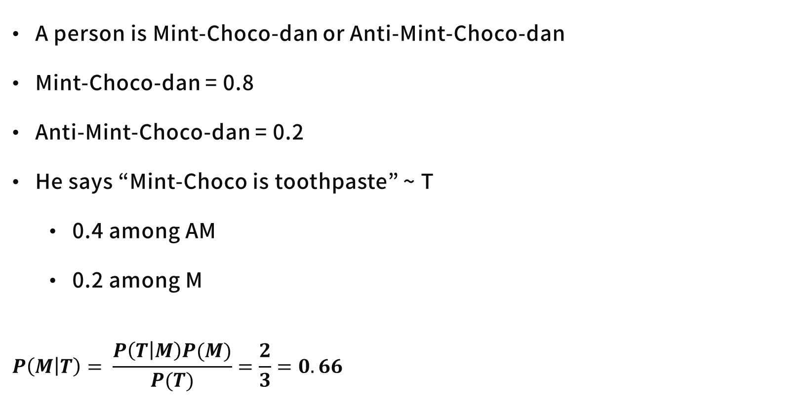
Bayesian – Bayes Rule
A person is Mint-Choco-dan or Anti-Mint-Choco-dan
Mint-Choco-dan = 0.8
Anti-Mint-Choco-dan = 0.2
He says “Mint-Choco is toothpaste” ~ T
0.4 among AM
0.2 among M
$$P\left(M | T\right)= \frac{P\left(T | M\right)P(M)}{P(T)}=\frac{2}{3}=0.66$$
AM
0.2
M
0.8
0.12
0.64
0.6
0.8
0.08
0.4
0.16
0.2

Slide 12
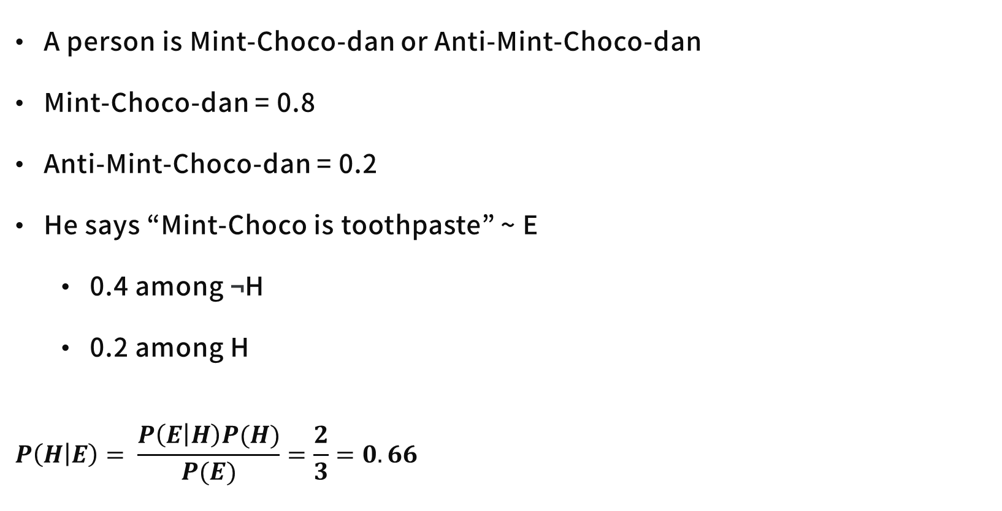
Bayesian – Bayes Rule
A person is Mint-Choco-dan or Anti-Mint-Choco-dan
Mint-Choco-dan = 0.8
Anti-Mint-Choco-dan = 0.2
He says “Mint-Choco is toothpaste” ~ E
0.4 among ¬H
0.2 among H
$$P\left(H | E\right)= \frac{P\left(E | H\right)P(H)}{P(E)}=\frac{2}{3}=0.66$$
AM
0.2
M
0.8
0.12
0.64
0.6
0.8
0.08
0.4
0.16
0.2

Slide 13
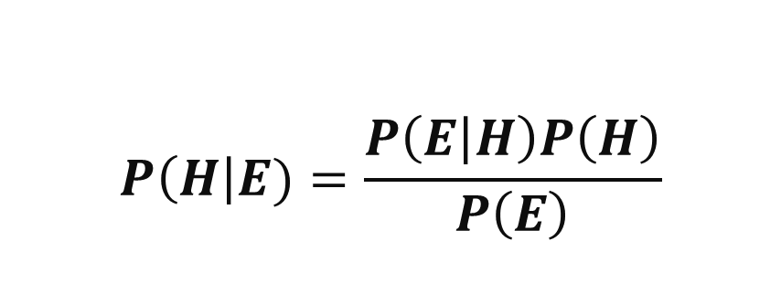
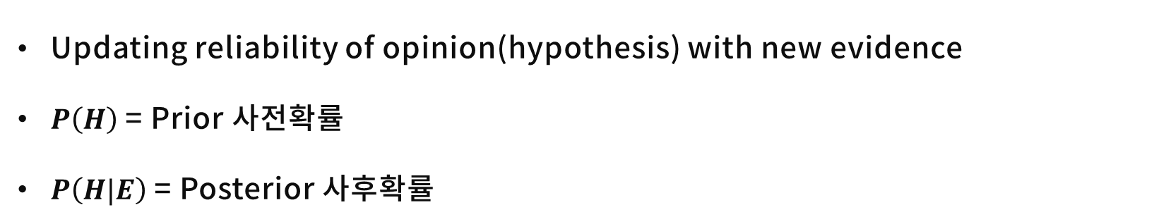
Bayesian – Bayes Rule
Updating reliability of opinion(hypothesis) with new evidence
$P\left(H\right)$ = Prior 사전확률
$P\left(H|E\right)$ = Posterior 사후확률
$$P\left(H\right|E)=\frac{P\left(E | H\right)P\left(H\right)}{P\left(E\right)}$$
Posterior
Prior

Slide 14
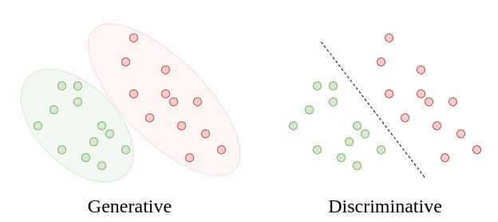
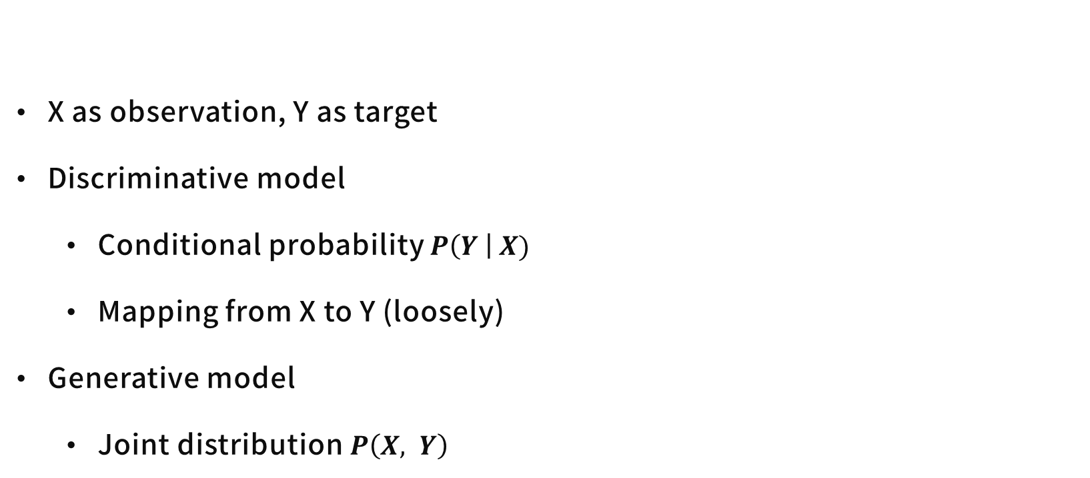
Generative Model
X as observation, Y as target
Discriminative model
Conditional probability $P\left(Y \right| X)$
Mapping from X to Y (loosely)
Generative model
Joint distribution $P\left(X, Y\right)$
https://www.baeldung.com/cs/ml-generative-vs-discriminative

Slide 15
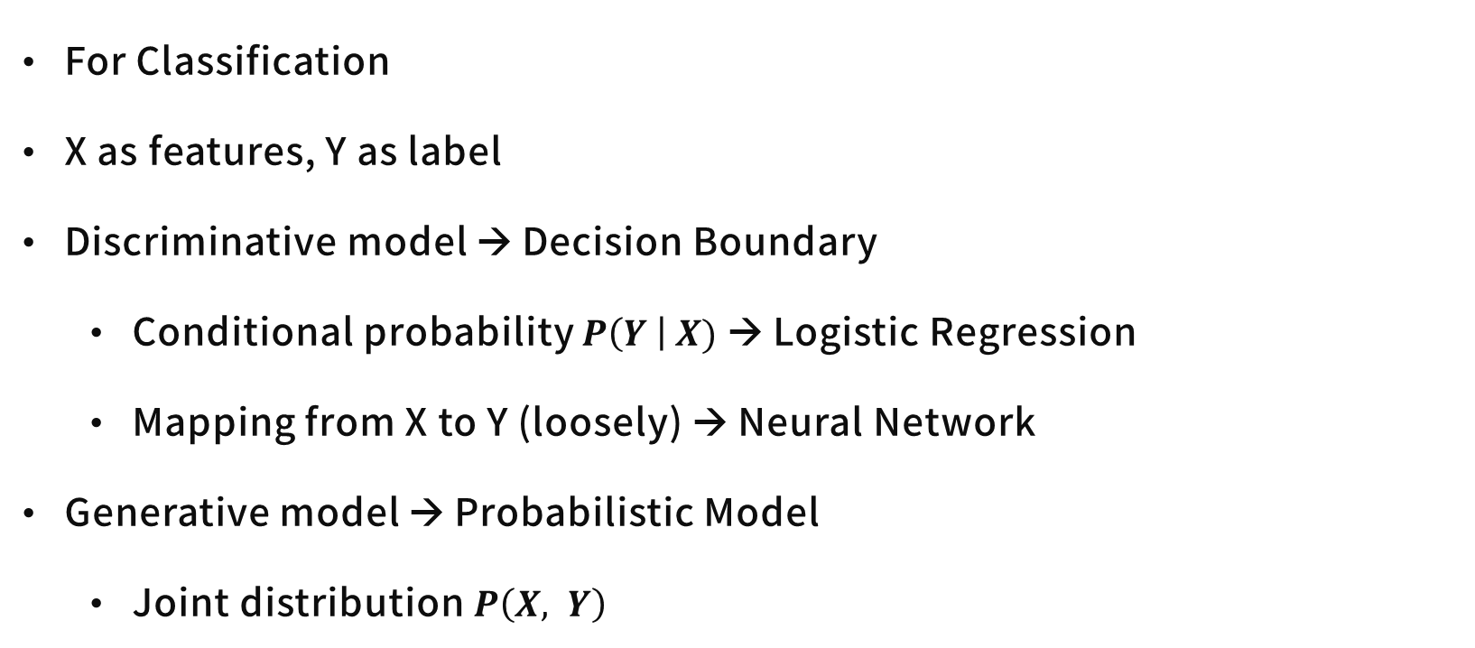
Generative Model
For Classification
X as features, Y as label
Discriminative model → Decision Boundary
Conditional probability $P\left(Y \right| X)$ → Logistic Regression
Mapping from X to Y (loosely) → Neural Network
Generative model → Probabilistic Model
Joint distribution $P\left(X, Y\right)$

Slide 16
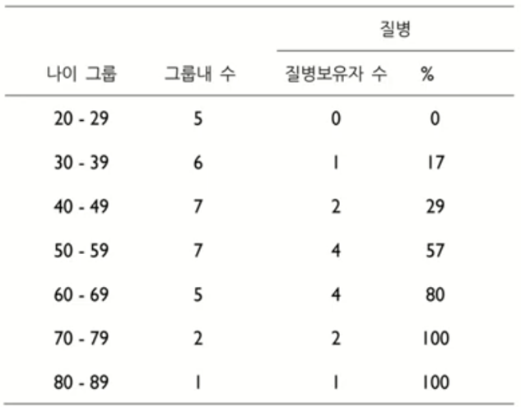
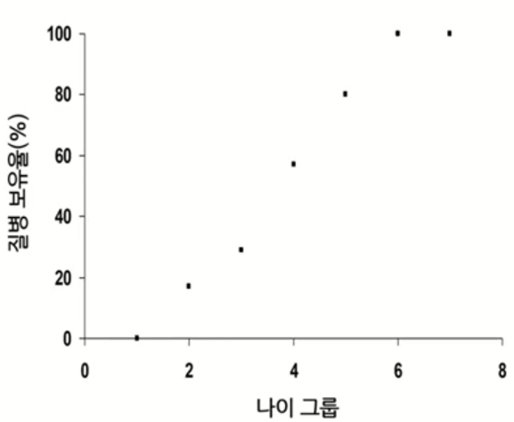
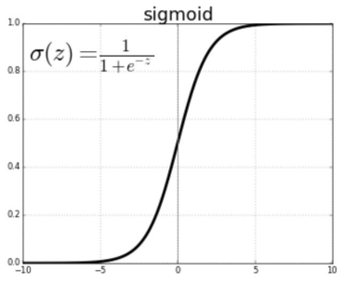
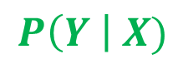
Generative Model
Y
For Classification
X as features, Y as label
Discriminative model → Decision Boundary
Conditional probability $P\left(Y \right| X)$ → Logistic Regression
Mapping from X to Y (loosely) → Neural Network
Generative model → Probabilistic Model
Joint distribution $P\left(X, Y\right)$
Decision Boundary
X
$$P\left(Y \right| X)$$
X

Slide 17
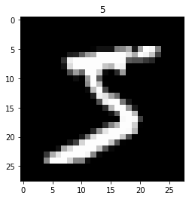
Generative Model
Describes how a dataset is generated in terms of a probabilistic model
: Sampling → Generate new data from learned distribution
How can we find distribution?
Ian Goodfellow, NIPS 2016 Tutorial: Generative Adversarial Networks

Slide 18
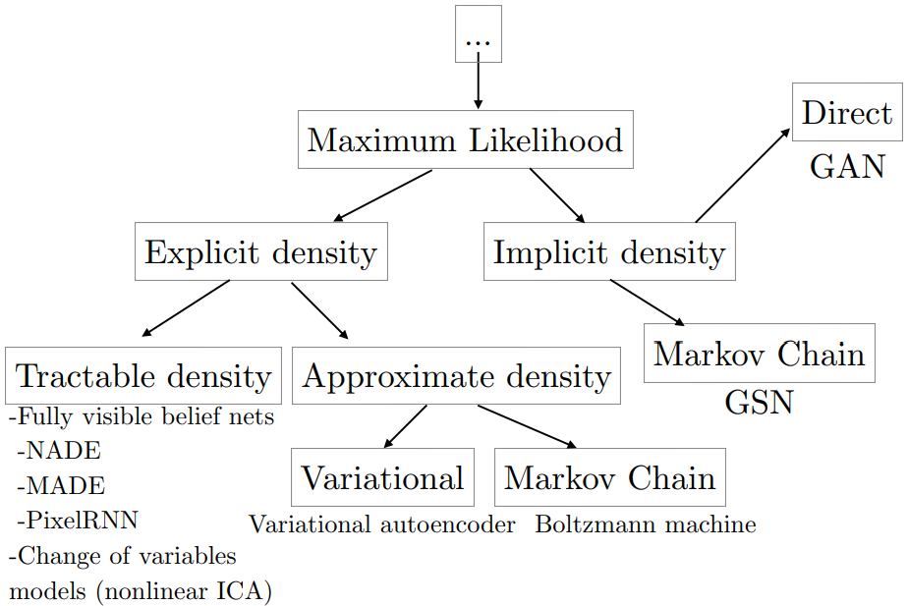
Generative Model
Describes how a dataset is generated in terms of a probabilistic model
: Sampling → Generate new data from learned distribution
Maximum Likelihood Estimation
Probability Density Function
Data Manifold
Generative Model Taxonomy →
Ian Goodfellow, NIPS 2016 Tutorial: Generative Adversarial Networks

Slide 19
Maximum Likelihood Estimation
Likelihood?
Discrete data → Probability Mass Function
Probability = Likelihood
Can calculate probability of certain point of data

Slide 20
Maximum Likelihood Estimation
Likelihood?
Continuous Data → Probability Density Function
Probability ≠ Likelihood
P (X = 4) = 0 ( = 1 / ∞ )
(Likelihood of X = 1) = 5

Slide 21
Maximum Likelihood Estimation
Some data are given
Probability distribution(parametric family) is given
Estimate parameter which maximizes the likelihood function

Slide 22
Maximum Likelihood Estimation
Some data are given
Probability distribution(parametric family) is given
Estimate parameter which maximizes the likelihood function

Slide 23
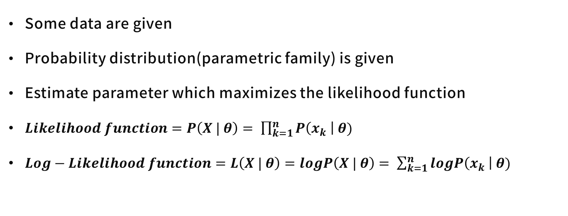
Maximum Likelihood Estimation
Some data are given
Probability distribution(parametric family) is given
Estimate parameter which maximizes the likelihood function
$Likelihood function=P\left(X | θ\right)= \prod_{k=1}^{n}{P\left(x_{k} \right| θ)}$
$Log−Likelihood function=L\left(X | θ\right)=logP\left(X | θ\right)= \sum_{k=1}^{n}{logP\left(x_{k} \right| θ)}$

Slide 24
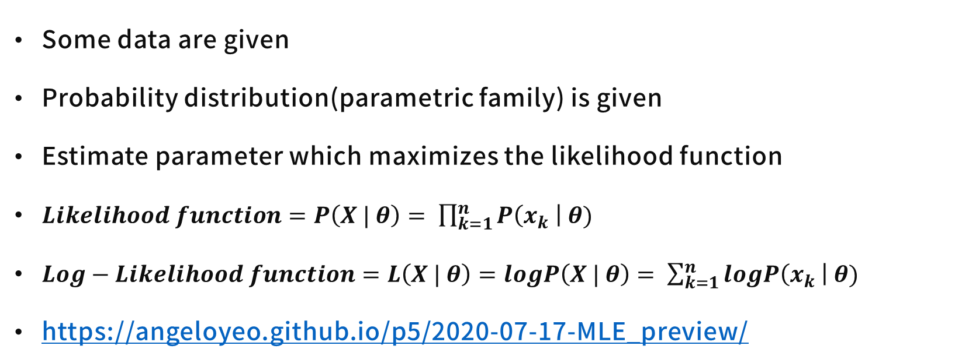
Maximum Likelihood Estimation
Some data are given
Probability distribution(parametric family) is given
Estimate parameter which maximizes the likelihood function
$Likelihood function=P\left(X | θ\right)= \prod_{k=1}^{n}{P\left(x_{k} \right| θ)}$
$Log−Likelihood function=L\left(X | θ\right)=logP\left(X | θ\right)= \sum_{k=1}^{n}{logP\left(x_{k} \right| θ)}$
https://angeloyeo.github.io/p5/2020-07-17-MLE_preview/

Slide 25
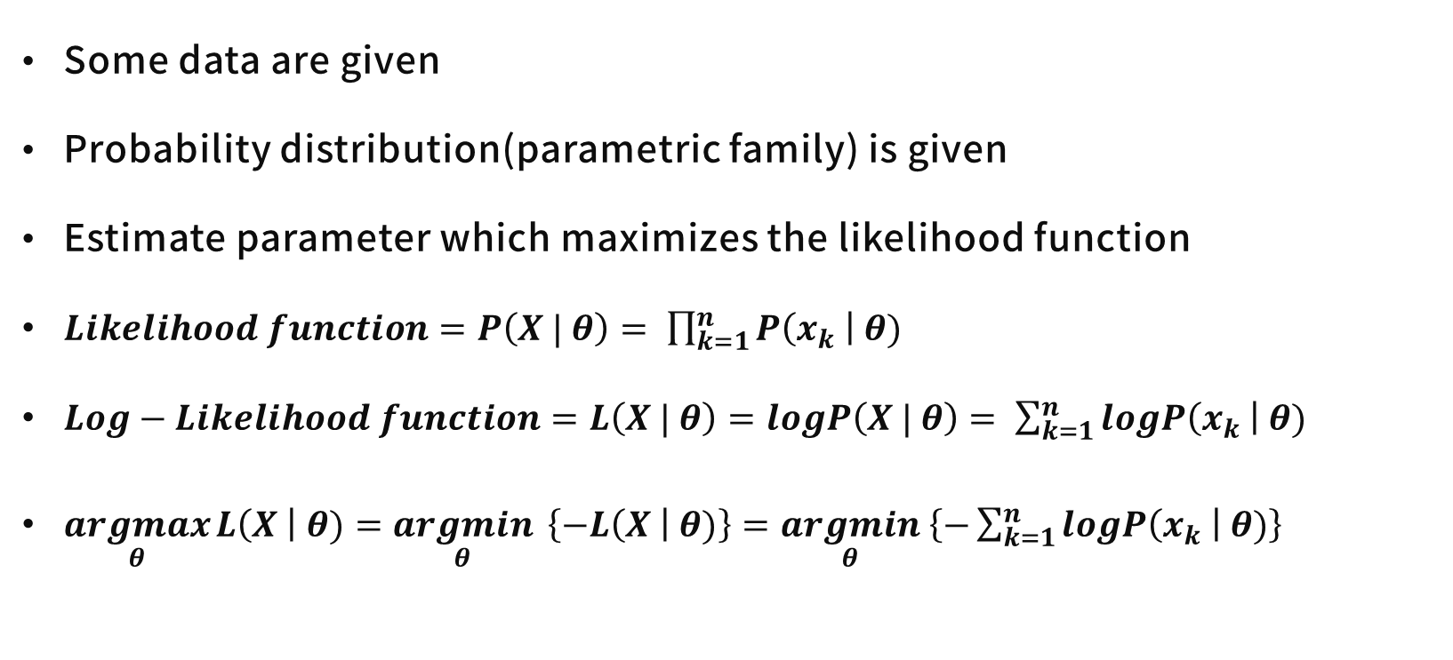
Maximum Likelihood Estimation
Some data are given
Probability distribution(parametric family) is given
Estimate parameter which maximizes the likelihood function
$Likelihood function=P\left(X | θ\right)= \prod_{k=1}^{n}{P\left(x_{k} \right| θ)}$
$Log−Likelihood function=L\left(X | θ\right)=logP\left(X | θ\right)= \sum_{k=1}^{n}{logP\left(x_{k} \right| θ)}$
$\underset{θ}{argmax}{L\left(X \right| θ)}=\underset{θ}{argmin}{ \left\{−L\left(X \right| θ)\right\}}=\underset{θ}{argmin} \left\{−\sum_{k=1}^{n}{logP\left(x_{k} \right| θ)}\right\}$

Slide 26
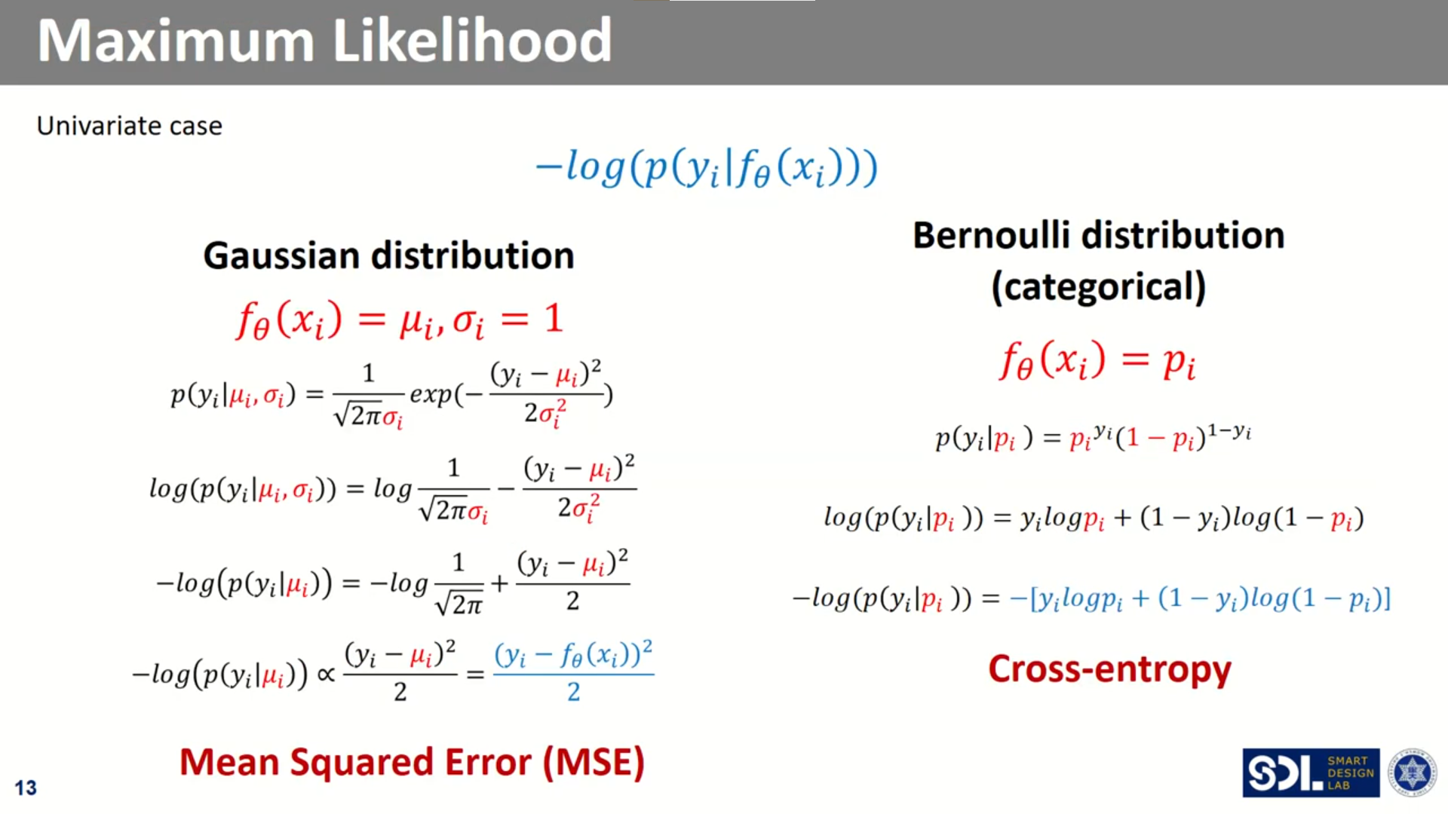
Maximum Likelihood Estimation – Loss Function w/t distribution
딥러닝 Ch3.1 비지도학습기초B, [Youtube] Smart Design Lab @ KAIST, https://youtu.be/QfHcuPPW6W4

Slide 27
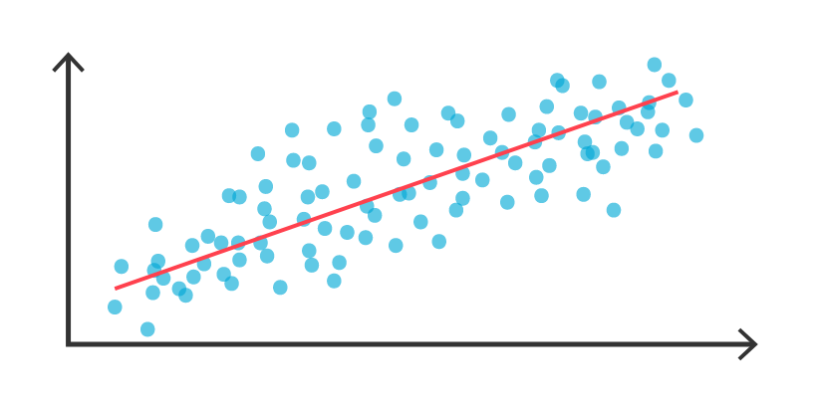
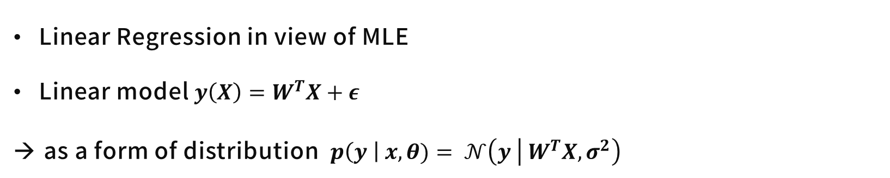
Maximum Likelihood Estimation
Linear Regression in view of MLE
Linear model $y\left(X\right)=W^{T}X+ε$
as a form of distribution $p\left(y \right| x, θ)= 𝒩\left(y | W^{T}X, σ^{2}\right)$
https://www.tibco.com/ko/reference-center/what-is-regression-analysis

Slide 28
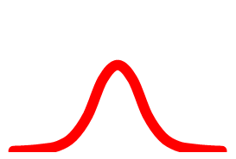
Maximum Likelihood Estimation
Linear Regression in view of MLE
Linear model $y\left(X\right)=W^{T}X+ε$
as a form of distribution $p\left(y \right| x, θ)= 𝒩\left(y | W^{T}X, σ^{2}\right)$
https://www.tibco.com/ko/reference-center/what-is-regression-analysis

Slide 29
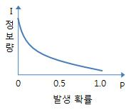
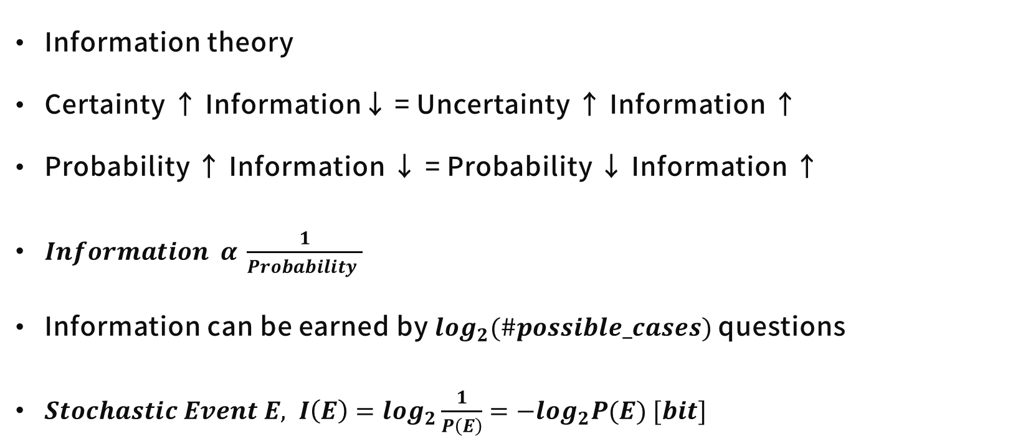
Entropy, Cross-Entropy
Information theory
Certainty ↑ Information↓ = Uncertainty ↑ Information ↑
Probability ↑ Information ↓ = Probability ↓ Information ↑
$Information α \frac{1}{Probability }$
Information can be earned by $log_{2}(\#possible_cases)$ questions
$Stochastic Event E, I\left(E\right)=log_{2}\frac{1}{P\left(E\right)}=−log_{2}P(E) [bit]$

Slide 30
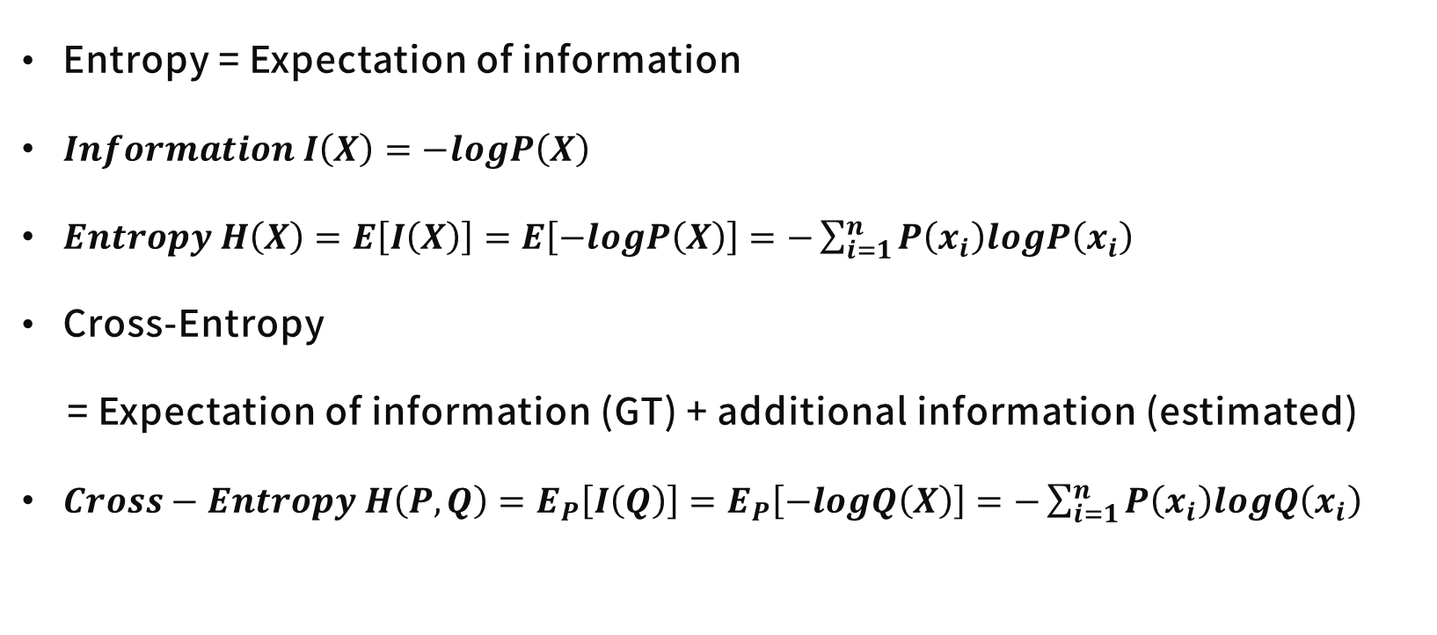
Entropy, Cross-Entropy
Entropy = Expectation of information
$Information I\left(X\right)=−logP\left(X\right)$
$Entropy H\left(X\right)=E\left[I\left(X\right)\right]=E\left[−logP\left(X\right)\right]=−\sum_{i=1}^{n}{P\left(x_{i}\right)logP\left(x_{i}\right)}$
Cross-Entropy
= Expectation of information (GT) + additional information (estimated)
$Cross−Entropy H\left(P, Q\right)=E_{P}\left[I\left(Q\right)\right]=E_{P}\left[−logQ\left(X\right)\right]=−\sum_{i=1}^{n}{P\left(x_{i}\right)logQ\left(x_{i}\right)}$

Slide 31
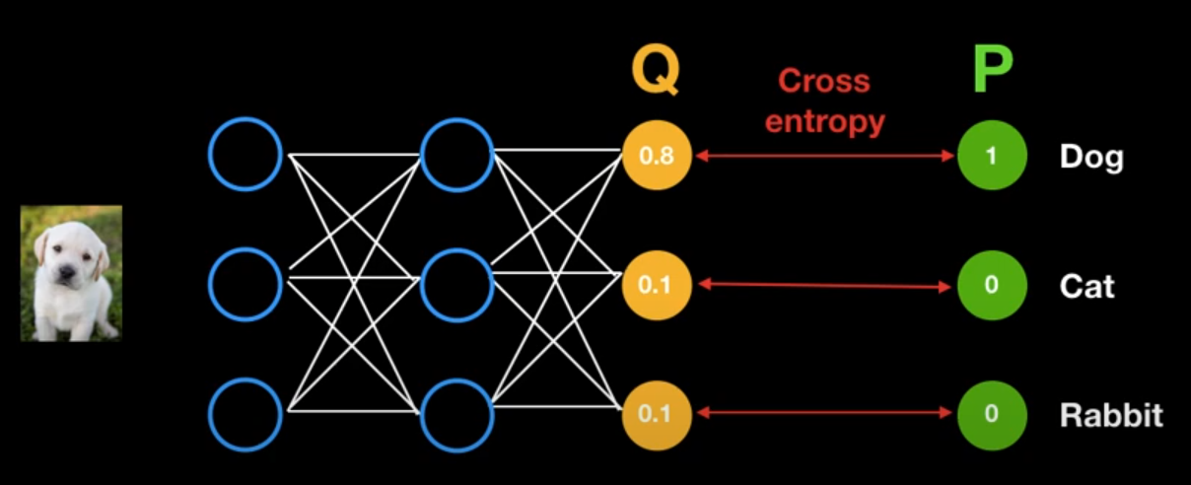
Entropy, Cross-Entropy
Entropy = Expectation of information
$Information I\left(X\right)=−logP\left(X\right)$
$Entropy H\left(X\right)=E\left[I\left(X\right)\right]=E\left[−logP\left(X\right)\right]=−\sum_{i=1}^{n}{P\left(x_{i}\right)logP\left(x_{i}\right)}$
Cross-Entropy
= Expectation of information (GT) + additional information (estimated)
$Cross−Entropy H\left(P, Q\right)=E_{P}\left[I\left(Q\right)\right]=E_{P}\left[−logQ\left(X\right)\right]=−\sum_{i=1}^{n}{P\left(x_{i}\right)logQ\left(x_{i}\right)}$
https://youtu.be/Jt5BS71uVfI

Slide 32
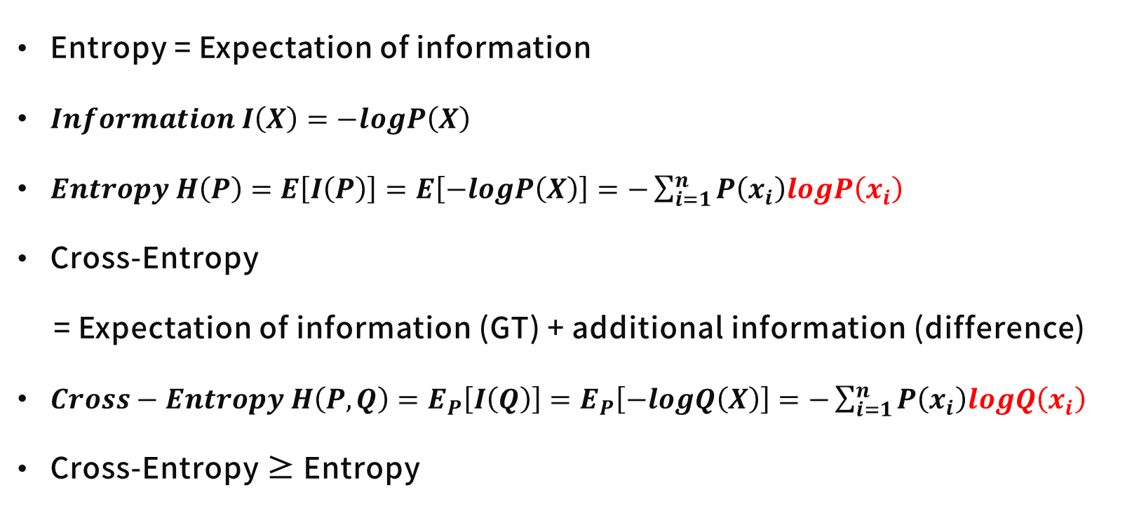
Entropy, Cross-Entropy
Entropy = Expectation of information
$Information I\left(X\right)=−logP\left(X\right)$
$Entropy H\left(P\right)=E\left[I\left(P\right)\right]=E\left[−logP\left(X\right)\right]=−\sum_{i=1}^{n}{P\left(x_{i}\right)logP\left(x_{i}\right)}$
Cross-Entropy
= Expectation of information (GT) + additional information (difference)
$Cross−Entropy H\left(P, Q\right)=E_{P}\left[I\left(Q\right)\right]=E_{P}\left[−logQ\left(X\right)\right]=−\sum_{i=1}^{n}{P\left(x_{i}\right)logQ\left(x_{i}\right)}$
Cross-Entropy ≥ Entropy
https://youtu.be/Jt5BS71uVfI

Slide 33
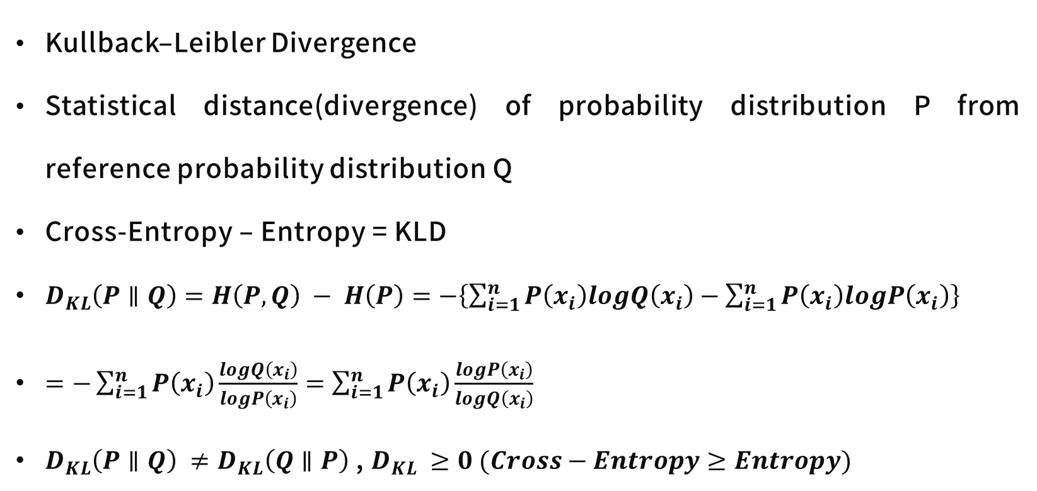
KL Divergence
Kullback–Leibler Divergence
Statistical distance(divergence) of probability distribution P from reference probability distribution Q
Cross-Entropy – Entropy = KLD
$D_{KL}\left(P∥Q\right)=H\left(P,Q\right) − H\left(P\right)=−\left\{\sum_{i=1}^{n}{P\left(x_{i}\right)logQ\left(x_{i}\right)}−\sum_{i=1}^{n}{P\left(x_{i}\right)logP\left(x_{i}\right)}\right\}$
$=−\sum_{i=1}^{n}{P\left(x_{i}\right)\frac{logQ\left(x_{i}\right)}{logP\left(x_{i}\right)}}=\sum_{i=1}^{n}{P\left(x_{i}\right)\frac{logP\left(x_{i}\right)}{logQ\left(x_{i}\right)}}$
$D_{KL}\left(P∥Q\right) ≠D_{KL}\left(Q∥P\right)$ , $D_{KL} ≥0 (Cross−Entropy≥Entropy)$

Slide 34
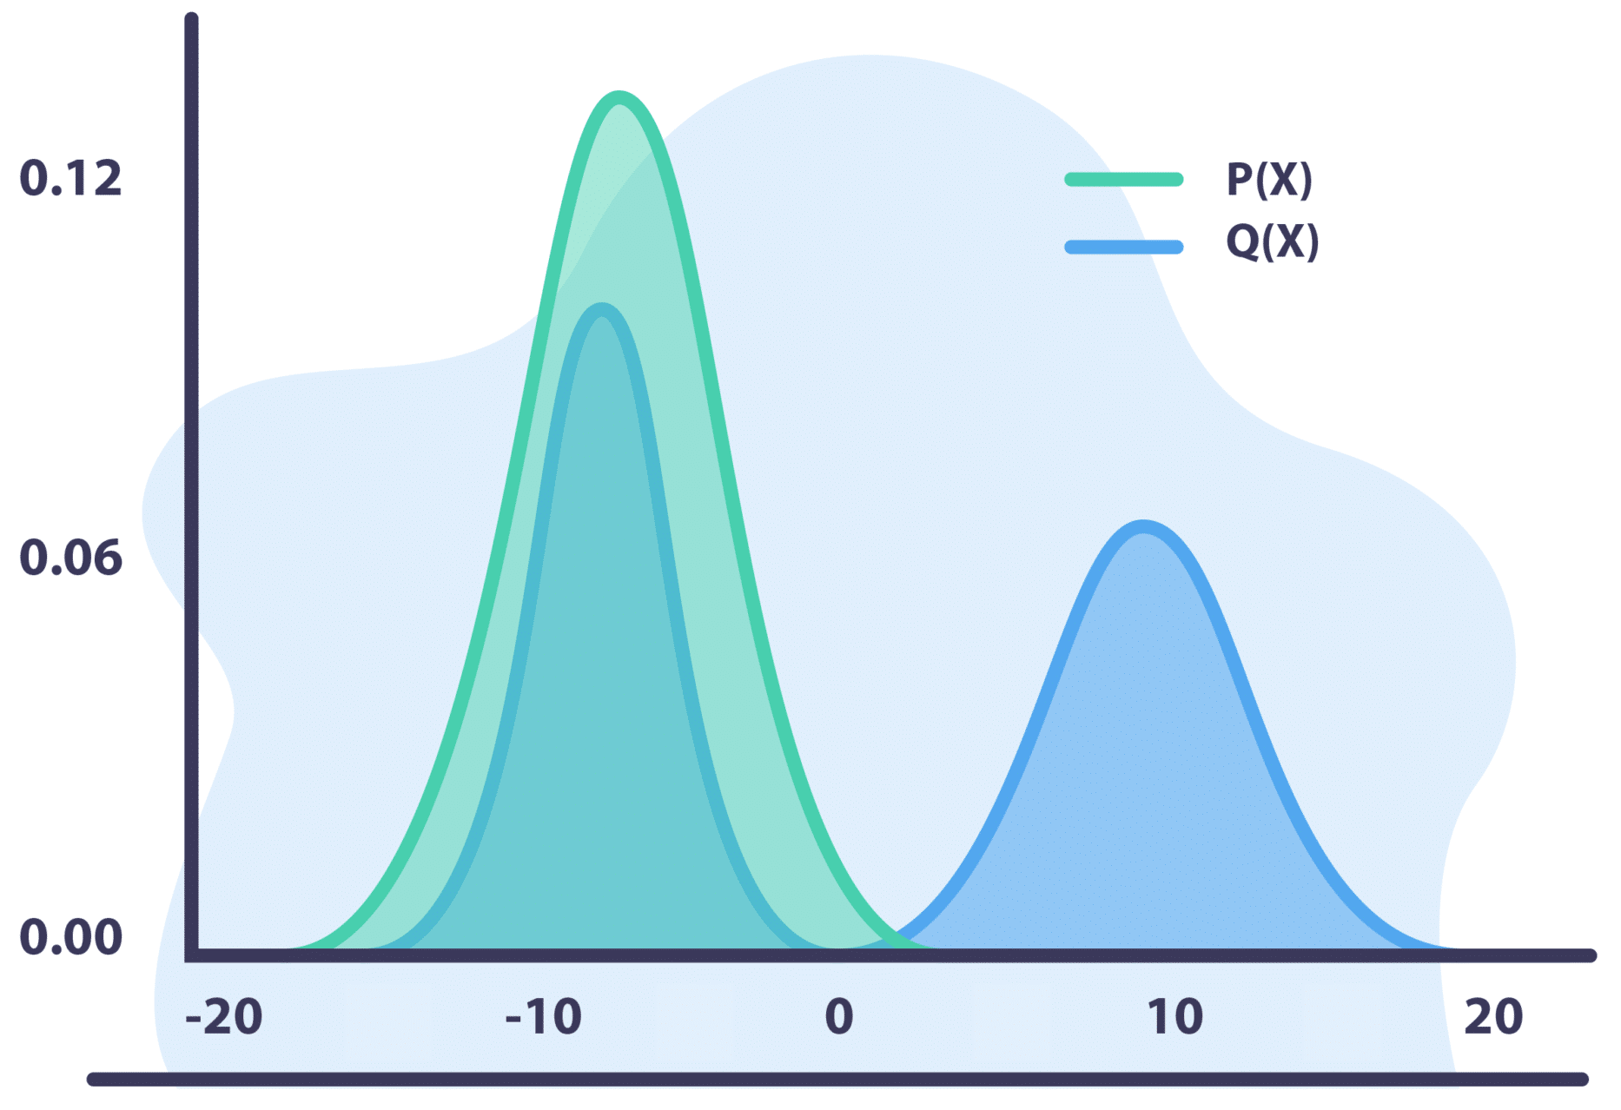
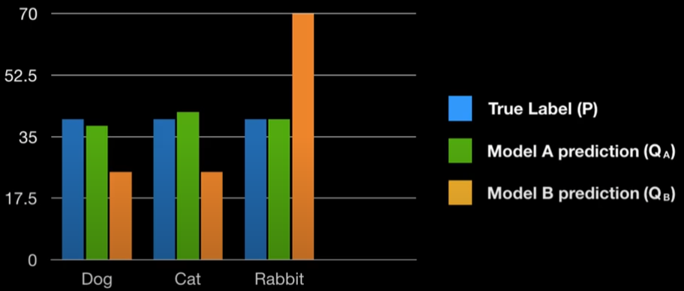
KL Divergence
Statistical distance(divergence) of probability distribution P from reference probability distribution Q
https://youtu.be/7GBXCD-B6fo, https://www.aporia.com/glossary/kullback-leibler-divergence/

Slide 35
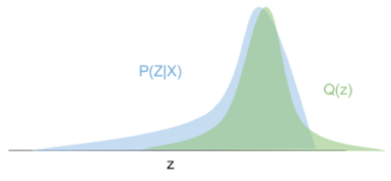
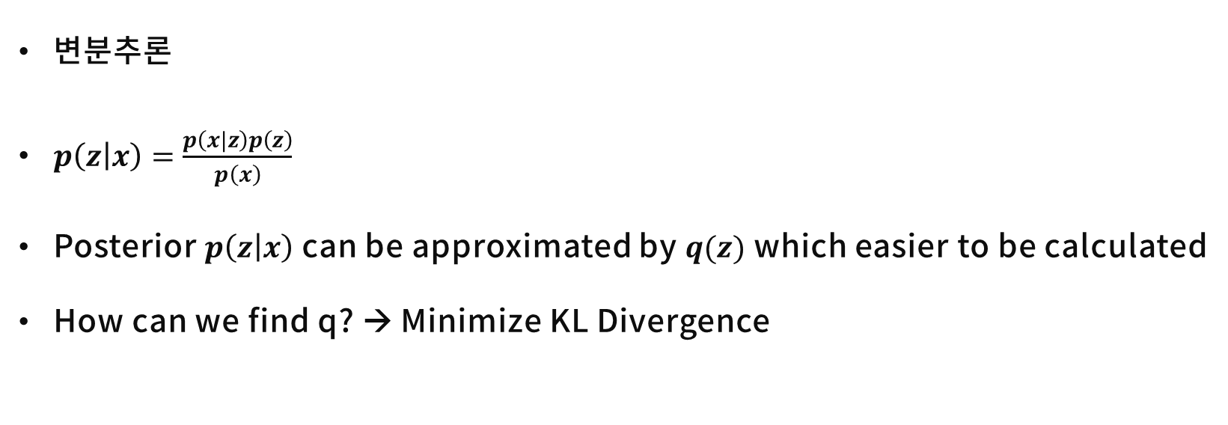
Variational Inference
변분추론
$p\left(z | x\right)=\frac{p\left(x|z\right)p\left(z\right)}{p\left(x\right)}$
Posterior $p\left(z | x\right)$ can be approximated by $q(z)$ which easier to be calculated
How can we find q? → Minimize KL Divergence
https://ratsgo.github.io/generative%20model/2017/12/19/vi/

Slide 36
Generative Model
Generative Model Taxonomy
Ian Goodfellow, NIPS 2016 Tutorial: Generative Adversarial Networks

Slide 37
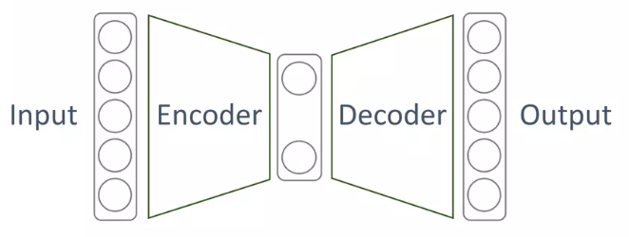
Auto-Encoder
Unsupervised Learning
Input x is encoded into latent feature z
Purpose of Auto-Encoder
Encoder with code z
Feature extractor
Data compressor
Decoder to calculate reconstruction error
Dimensionality reduction to manifold
https://www.slideshare.net/NaverEngineering/ss-96581209

Slide 38
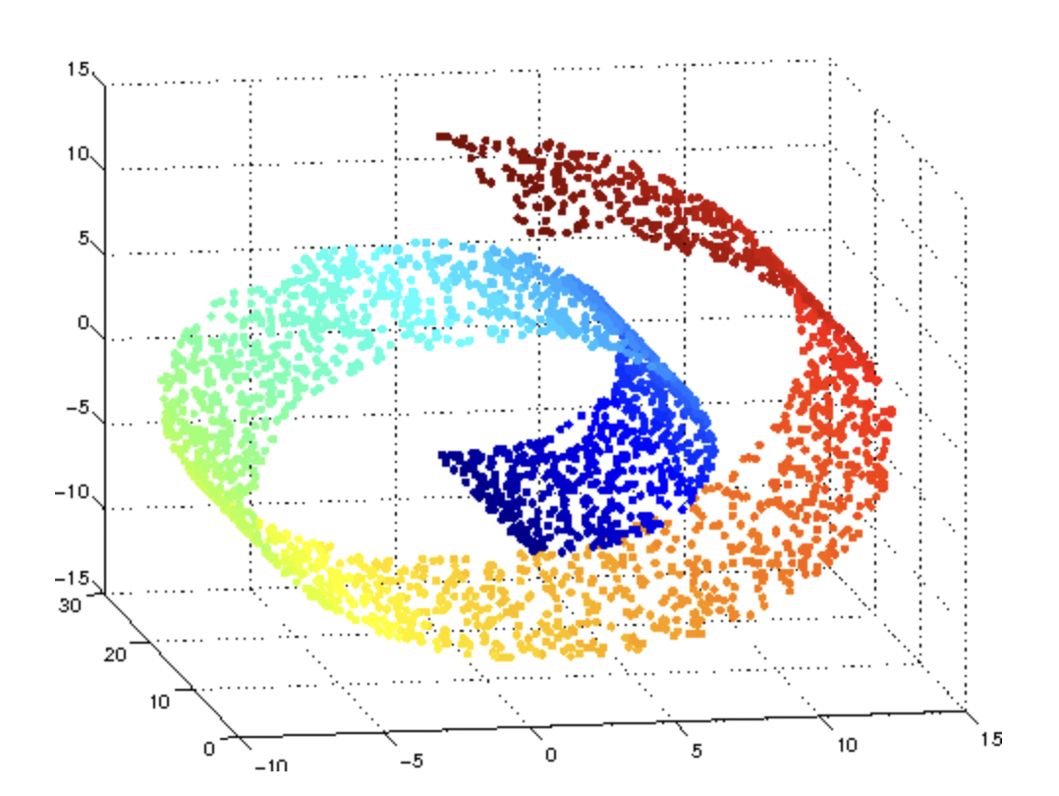
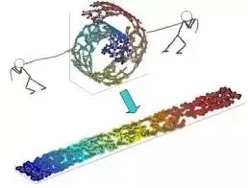
Data Manifold
Curse of dimensionality
Manifold Hypothesis
Subspace(manifold) describing data
Transform data into manifold
https://www.quora.com/What-is-manifold-learning

Slide 39
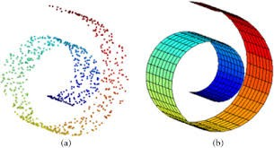
Data Manifold
Curse of dimensionality
Manifold Hypothesis
Subspace(manifold) describing data
Transform data into manifold
https://towardsdatascience.com/manifolds-in-data-science-a-brief-overview-2e9dde9437e5

Slide 40
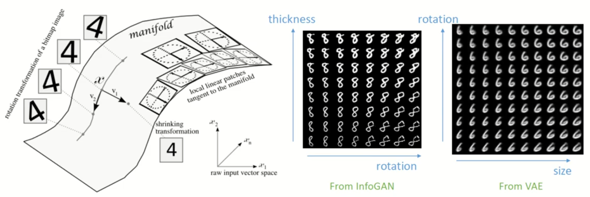
Data Manifold
Curse of dimensionality
Manifold Hypothesis
Subspace(manifold) describing data
Transform data into manifold
https://towardsdatascience.com/https://youtu.be/QfHcuPPW6W4

Slide 41
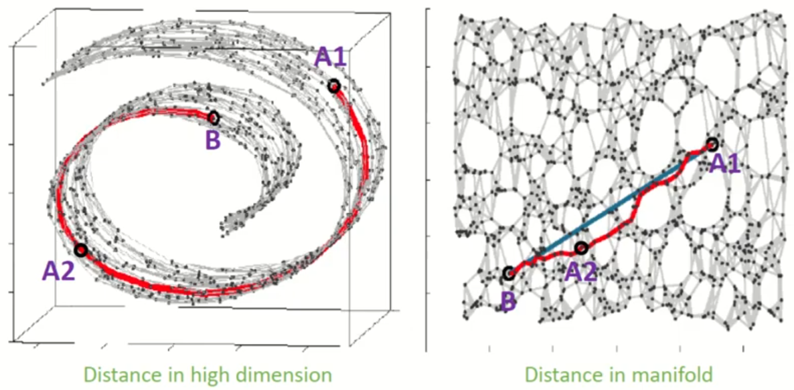
Data Manifold
Curse of dimensionality
Manifold Hypothesis
Subspace(manifold) describing data
Transform data into manifold
https://youtu.be/QfHcuPPW6W4

Slide 42
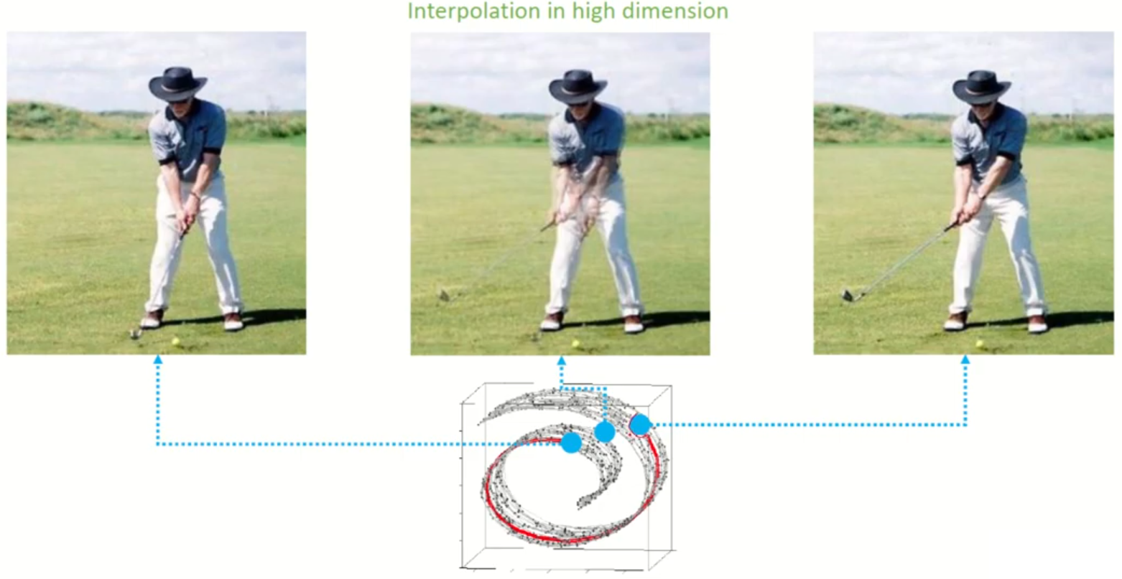
Data Manifold
Curse of dimensionality
Manifold Hypothesis
Subspace(manifold) describing data
Transform data into manifold
https://youtu.be/QfHcuPPW6W4

Slide 43
Data Manifold
Curse of dimensionality
Manifold Hypothesis
Subspace(manifold) describing data
Transform data into manifold
https://youtu.be/QfHcuPPW6W4

Slide 44
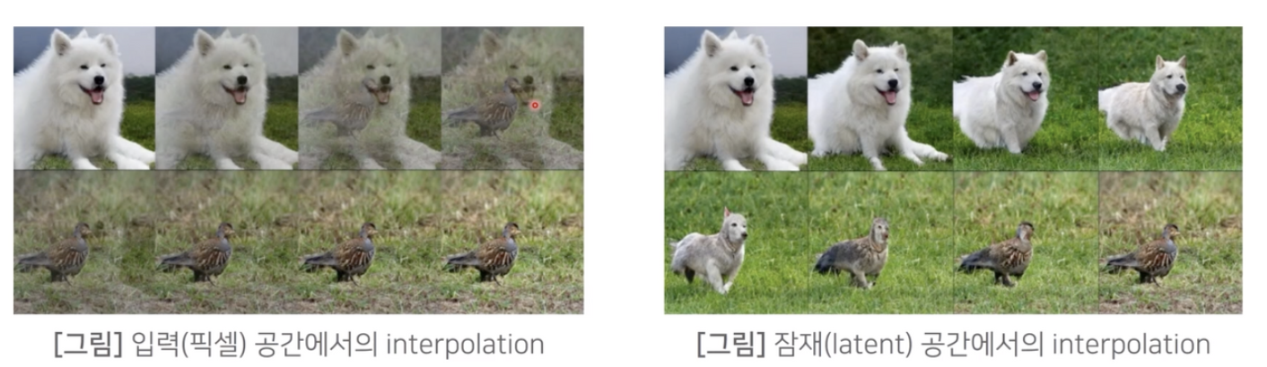
Data Manifold
Curse of dimensionality
Manifold Hypothesis
Subspace(manifold) describing data
Transform data into manifold
https://velog.io/@xuio/TIL-Data-Manifold-%ED%95%99%EC%8A%B5%EC%9D%B4%EB%9E%80

Slide 45
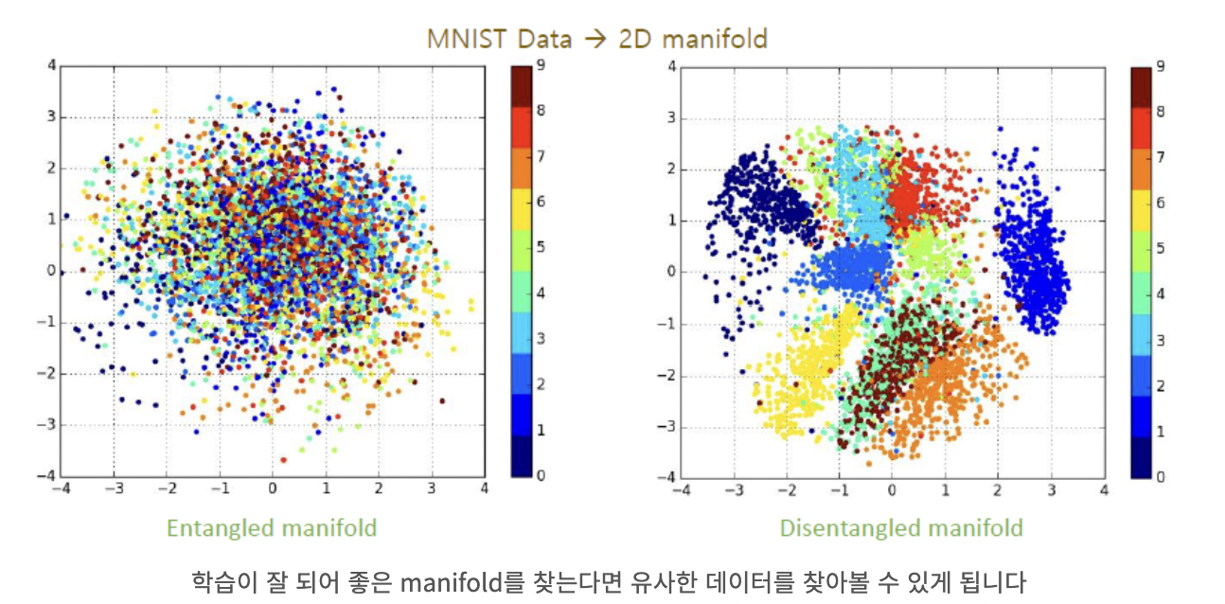
Data Manifold
Curse of dimensionality
Manifold Hypothesis
Subspace(manifold) describing data
Transform data into manifold
Auto-Encoder
…
https://velog.io/@xuio/TIL-Data-Manifold-%ED%95%99%EC%8A%B5%EC%9D%B4%EB%9E%80

Slide 46
Question?

Slide 47
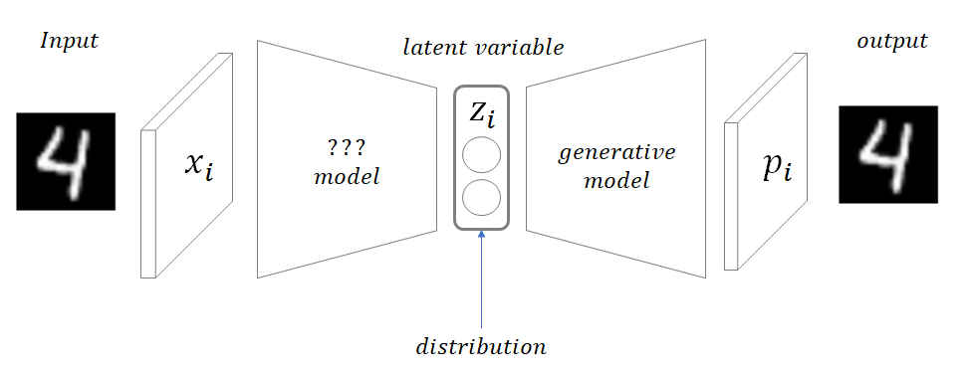
Variational Auto-Encoder (VAE)
Similar structure with Auto-Encoder
Different purpose
AE : Encoder (Feature extraction, compression, manifold, encoding …)
VAE : Decoder (Data Generation, Density Estimation)
https://taeu.github.io/paper/deeplearning-paper-vae/

Slide 48
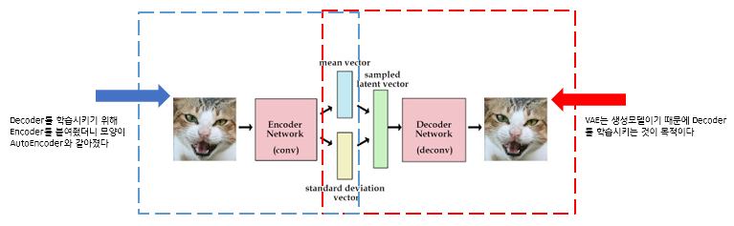
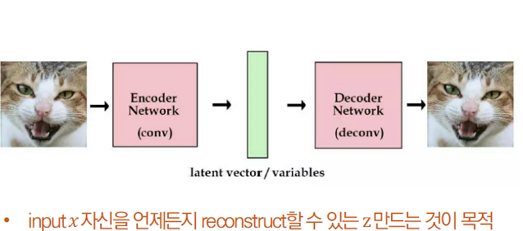
Variational Auto-Encoder (VAE)
VAE
Similar structure with Auto-Encoder
Different purpose
AE : Encoder (Feature extraction, compression, manifold, encoding …)
VAE : Decoder (Data Generation, Density Estimation)
AE
https://wikidocs.net/152474

Slide 49
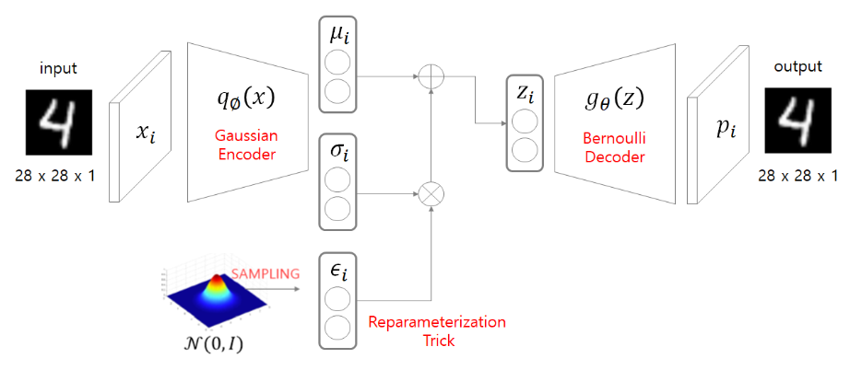
Variational Auto-Encoder (VAE)
Overall structure
Input → mean, variance → Normal distribution → sampling → generation by decoder
https://taeu.github.io/paper/deeplearning-paper-vae/

Slide 50
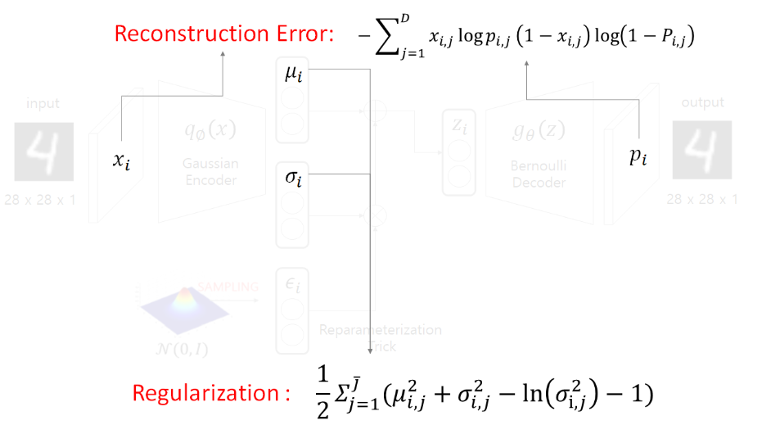
Variational Auto-Encoder (VAE) – Loss Function
Loss Function
Reconstruction Error (Input, Generated output)
Regularization (Assumption for distribution)
https://taeu.github.io/paper/deeplearning-paper-vae/

Slide 51
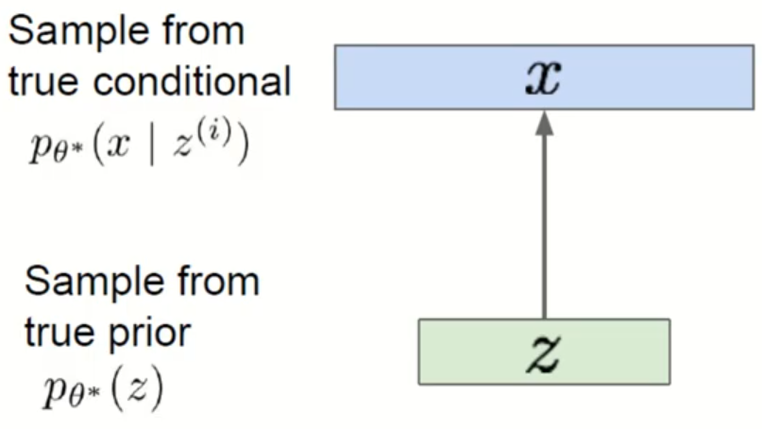
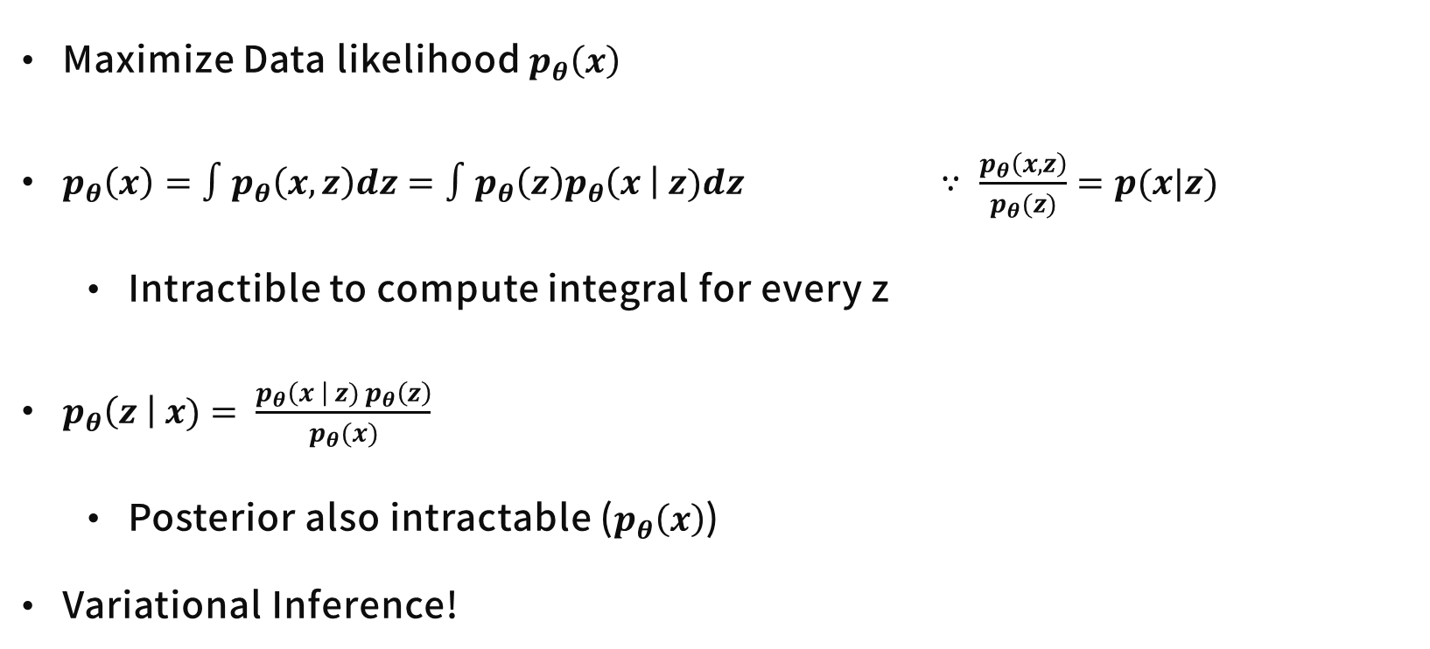
Variational Auto-Encoder (VAE) – Loss Function
Maximize Data likelihood $p_{θ}\left(x\right)$
$p_{θ}\left(x\right)=∫p_{θ}\left(x, z\right)dz=∫p_{θ}\left(z\right)p_{θ}\left(x \right| z)dz$ $∵ \frac{p_{θ}\left(x, z\right)}{p_{θ}(z)}=p(x|z)$
Intractible to compute integral for every z
$p_{θ}\left(z \right| x)= \frac{p_{θ}\left(x \right| z) p_{θ}\left(z\right)}{p_{θ}(x)}$
Posterior also intractable ($p_{θ}\left(x\right)$)
Variational Inference!
https://youtu.be/GbCAwVVKaHY

Slide 52
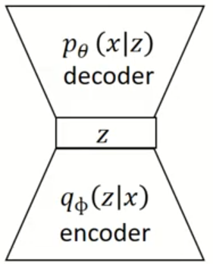

Variational Auto-Encoder (VAE) – Loss Function
Maximize Data likelihood $p_{θ}\left(x\right)$
$p_{θ}\left(x\right)=∫p_{θ}\left(x, z\right)dz=∫p_{θ}\left(z\right)p_{θ}\left(x \right| z)dz$ $∵ \frac{p_{θ}\left(x, z\right)}{p_{θ}(z)}=p(x|z)$
Intractible to compute integral for every z
$p_{θ}\left(z \right| x)= \frac{p_{θ}\left(x \right| z) p_{θ}\left(z\right)}{p_{θ}(x)}$
Posterior also intractable ($p_{θ}\left(x\right)$)
Variational Inference!
Encoder with $q_{φ}\left(z \right| x)$ to approximate $p_{θ}\left(z \right| x)$
https://youtu.be/GbCAwVVKaHY

Slide 53

Variational Auto-Encoder (VAE) – Maximize log-likelihood
${log p}_{θ}\left(x^{(i)}\right)=E_{z\sim q_{φ}(z|x^{\left(i\right)})}\left[log p_{θ}\left(x^{\left(i\right)}\right)\right]$
$=E_{z}\left[log\frac{p_{θ}\left(x^{\left(i\right)}\right| z) p_{θ}(z)}{p_{θ}(z|x^{(i)})}\right]$ $∵Bayes Rule$
$=E_{z}\left[log\frac{p_{θ}\left(x^{\left(i\right)}\right| z) p_{θ}(z)}{p_{θ}(z|x^{(i)})}\frac{q_{φ}(z|x^{\left(i\right)})}{q_{φ}(z|x^{\left(i\right)})}\right]=E_{z}\left[log\frac{p_{θ}\left(x^{\left(i\right)}\right| z) p_{θ}(z)}{q_{φ}(z|x^{\left(i\right)})}\frac{q_{φ}(z|x^{\left(i\right)})}{p_{θ}(z|x^{(i)})}\right]$
$=E_{z}\left[log p_{θ} (x^{\left(i\right)}|z)\right] −E_{z}\left[log\frac{q_{φ}\left(z|x^{\left(i\right)}\right)}{p_{θ}\left(z\right)}\right]+E_{z}\left[log\frac{q_{φ}(z|x^{\left(i\right)})}{p_{θ}(z|x^{(i)})}\right]$
https://youtu.be/GbCAwVVKaHY

Slide 54

Variational Auto-Encoder (VAE) – Maximize log-likelihood
$=E_{z}\left[log p_{θ} (x^{\left(i\right)}|z)\right] −E_{z}\left[log\frac{q_{φ}\left(z|x^{\left(i\right)}\right)}{p_{θ}\left(z\right)}\right]+E_{z}\left[log\frac{q_{φ}\left(z | x^{\left(i\right)}\right)}{p_{θ}\left(z | x^{\left(i\right)}\right)}\right]$
$∵ E_{z\sim q_{φ}(z|x^{\left(i\right)})}\left[log\frac{q_{φ}\left(z|x^{\left(i\right)}\right)}{p_{θ}\left(z\right)}\right]= \int_{z}{q_{φ}\left(z | x^{\left(i\right)}\right) log\frac{q_{φ}\left(z|x^{\left(i\right)}\right)}{p_{θ}\left(z\right)}}$
$∵D_{KL}\left(P∥Q\right)=\int_{x}{P\left(x_{i}\right)\frac{logP\left(x_{i}\right)}{logQ\left(x_{i}\right)}}$
$=E_{z}\left[log p_{θ} (x^{\left(i\right)}|z)\right] −D_{KL}(q_{φ}\left(z|x^{\left(i\right)}\right)∥p_{θ}\left(z\right))$ $+ D_{KL}(q_{φ}\left(z|x^{\left(i\right)}\right)∥p_{θ}\left(z | x^{(i)}\right))$
https://youtu.be/GbCAwVVKaHY

Slide 55

Variational Auto-Encoder (VAE) – Maximize log-likelihood
${log p}_{θ}\left(x^{(i)}\right)=E_{z\sim q_{φ}(z|x^{\left(i\right)})}\left[log p_{θ}\left(x^{\left(i\right)}\right)\right]$
$=E_{z}\left[log\frac{p_{θ}\left(x^{\left(i\right)}\right| z) p_{θ}(z)}{p_{θ}(z|x^{(i)})}\right]$ $∵Bayes Rule$
$=E_{z}\left[log\frac{p_{θ}\left(x^{\left(i\right)}\right| z) p_{θ}(z)}{p_{θ}(z|x^{(i)})}\frac{q_{φ}(z|x^{\left(i\right)})}{q_{φ}(z|x^{\left(i\right)})}\right]=E_{z}\left[log\frac{p_{θ}\left(x^{\left(i\right)}\right| z) p_{θ}(z)}{q_{φ}(z|x^{\left(i\right)})}\frac{q_{φ}(z|x^{\left(i\right)})}{p_{θ}(z|x^{(i)})}\right]$
$=E_{z}\left[log p_{θ} (x^{\left(i\right)}|z)\right] −E_{z}\left[log\frac{q_{φ}\left(z|x^{\left(i\right)}\right)}{p_{θ}\left(z\right)}\right]+E_{z}\left[log\frac{q_{φ}(z|x^{\left(i\right)})}{p_{θ}(z|x^{(i)})}\right]$
$=E_{z}\left[log p_{θ} (x^{\left(i\right)}|z)\right] −D_{KL}(q_{φ}\left(z|x^{\left(i\right)}\right)∥p_{θ}\left(z\right))$ $+ D_{KL}(q_{φ}\left(z|x^{\left(i\right)}\right)∥p_{θ}\left(z | x^{(i)}\right))$
https://youtu.be/GbCAwVVKaHY

Slide 56
Variational Auto-Encoder (VAE) – Maximize log-likelihood
${log p}_{θ}\left(x^{(i)}\right)=E_{z\sim q_{φ}(z|x^{\left(i\right)})}\left[log p_{θ}\left(x^{\left(i\right)}\right)\right]$
$=E_{z}\left[log\frac{p_{θ}\left(x^{\left(i\right)}\right| z) p_{θ}(z)}{p_{θ}(z|x^{(i)})}\right]$ $∵Bayes Rule$
$=E_{z}\left[log\frac{p_{θ}\left(x^{\left(i\right)}\right| z) p_{θ}(z)}{p_{θ}(z|x^{(i)})}\frac{q_{φ}(z|x^{\left(i\right)})}{q_{φ}(z|x^{\left(i\right)})}\right]=E_{z}\left[log\frac{p_{θ}\left(x^{\left(i\right)}\right| z) p_{θ}(z)}{q_{φ}(z|x^{\left(i\right)})}\frac{q_{φ}(z|x^{\left(i\right)})}{p_{θ}(z|x^{(i)})}\right]$
$=E_{z}\left[log p_{θ} (x^{\left(i\right)}|z)\right] −E_{z}\left[log\frac{q_{φ}\left(z|x^{\left(i\right)}\right)}{p_{θ}\left(z\right)}\right]+E_{z}\left[log\frac{q_{φ}(z|x^{\left(i\right)})}{p_{θ}(z|x^{(i)})}\right]$
$=E_{z}\left[log p_{θ} (x^{\left(i\right)}|z)\right] −D_{KL}(q_{φ}\left(z|x^{\left(i\right)}\right)∥p_{θ}\left(z\right))$ $+ D_{KL}(q_{φ}\left(z|x^{\left(i\right)}\right)∥p_{θ}\left(z | x^{(i)}\right))$
Controllable
Intractable
https://youtu.be/GbCAwVVKaHY

Slide 57

Variational Auto-Encoder (VAE) – Maximize log-likelihood
${log p}_{θ}\left(x^{(i)}\right)=E_{z\sim q_{φ}(z|x^{\left(i\right)})}\left[log p_{θ}\left(x^{\left(i\right)}\right)\right]$
$=E_{z}\left[log\frac{p_{θ}\left(x^{\left(i\right)}\right| z) p_{θ}(z)}{p_{θ}(z|x^{(i)})}\right]$ $∵Bayes Rule$
$=E_{z}\left[log\frac{p_{θ}\left(x^{\left(i\right)}\right| z) p_{θ}(z)}{p_{θ}(z|x^{(i)})}\frac{q_{φ}(z|x^{\left(i\right)})}{q_{φ}(z|x^{\left(i\right)})}\right]=E_{z}\left[log\frac{p_{θ}\left(x^{\left(i\right)}\right| z) p_{θ}(z)}{q_{φ}(z|x^{\left(i\right)})}\frac{q_{φ}(z|x^{\left(i\right)})}{p_{θ}(z|x^{(i)})}\right]$
$=E_{z}\left[log p_{θ} (x^{\left(i\right)}|z)\right] −E_{z}\left[log\frac{q_{φ}\left(z|x^{\left(i\right)}\right)}{p_{θ}\left(z\right)}\right]+E_{z}\left[log\frac{q_{φ}(z|x^{\left(i\right)})}{p_{θ}(z|x^{(i)})}\right]$
$=E_{z}\left[log p_{θ} (x^{\left(i\right)}|z)\right] −D_{KL}(q_{φ}\left(z|x^{\left(i\right)}\right)∥p_{θ}\left(z\right))$ $+ D_{KL}(q_{φ}\left(z|x^{\left(i\right)}\right)∥p_{θ}\left(z | x^{(i)}\right))$
Tractable lower bound $𝓛(x^{\left(i\right)},θ, φ)$
≥0
https://youtu.be/GbCAwVVKaHY

Slide 58

Variational Auto-Encoder (VAE) – Maximize log-likelihood
$Maximize {log p}_{θ}\left(x^{(i)}\right)=E_{z\sim q_{φ}(z|x^{\left(i\right)})}\left[log p_{θ}\left(x^{\left(i\right)}\right)\right]$
$=E_{z}\left[log p_{θ} (x^{\left(i\right)}|z)\right] −D_{KL}(q_{φ}\left(z|x^{\left(i\right)}\right)∥p_{θ}\left(z\right))$ $+ D_{KL}\left(q_{φ}\left(z|x^{\left(i\right)}\right)∥p_{θ}\left(z | x^{\left(i\right)}\right)\right)$
$≥𝓛\left(x^{\left(i\right)},θ, φ\right)$
$Maximize 𝓛\left(x^{\left(i\right)},θ, φ\right)$ (ELBO : (Variational) Evidence Lower Bound)
$\underset{θ, φ}{argmax} \sum_{i=1}^{N}{𝓛\left(x^{\left(i\right)},θ, φ\right) }$
https://youtu.be/GbCAwVVKaHY

Slide 59


Variational Auto-Encoder (VAE) – Loss Function
$\underset{θ, φ}{argmax} \sum_{i=1}^{N}{𝓛\left(x^{\left(i\right)},θ, φ\right) }=\underset{θ, φ}{argmin} \sum_{i=1}^{N}{𝓛\left(x^{\left(i\right)},θ, φ\right) }$
$=\underset{θ, φ}{argmin} \sum_{i}{−E_{q_{φ}\left(z|x^{\left(i\right)}\right)}\left[log⁡({p(x}^{\left(i\right)}|g_{θ}(z)))\right]+D_{KL}(q_{φ}\left(z|x^{\left(i\right)}\right)∥p\left(z\right))}$
Reconstruction Error : Input - Generated output
Regularization : Assumption for distribution
Reconstruction Error
Regularization
https://youtu.be/GbCAwVVKaHY

Slide 60


Variational Auto-Encoder (VAE) – Optimization
Regularization
$D_{KL}\left(q_{φ}\left(z|x^{\left(i\right)}\right)∥p\left(z\right)\right)$
Assumption
$q_{φ}\left(z|x_{i}\right) \sim 𝒩\left(μ_{i}, σ_{i}^{2}, I\right)$ : multivariate gaussian distribution, diagonal covariance
$p\left(z\right) \sim 𝒩\left(0, 1\right)$ : multivariate normal distribution
https://youtu.be/GbCAwVVKaHY

Slide 61


Variational Auto-Encoder (VAE) – Optimization
Regularization
$D_{KL}\left(q_{φ}\left(z|x^{\left(i\right)}\right)∥p\left(z\right)\right)$
Assumption
$𝒩_{0}=𝒩\left(μ_{i}, σ_{i}^{2}, I\right)$
$𝒩_{1}= 𝒩\left(0, 1\right)$
$=\frac{1}{2} \sum_{j=1}^{J}{\left(μ_{i, j}^{2}+σ_{i, j}^{2} −ln\left(σ_{i, j}^{2}\right)−1\right)}$
https://youtu.be/GbCAwVVKaHY

Slide 62

Variational Auto-Encoder (VAE) – Optimization
Reconstruction Error
$E_{q_{φ}\left(z|x^{\left(i\right)}\right)}\left[log⁡({p(x}^{\left(i\right)}|z))\right]=∫log\left(p_{θ}\left(x_{i} | z\right)\right)q_{φ}\left(z | x_{i}\right)dz$
$Monte−Carlo technique ≈\frac{1}{L} \sum_{z^{i, l}}{log(p_{θ}\left(x_{i} | z^{i, l}\right))}$
$→L=1≈log(p_{θ}\left(x_{i} | z^{i}\right))$
https://youtu.be/GbCAwVVKaHY

Slide 63

Variational Auto-Encoder (VAE) – Reparameterization Trick
Cannot apply differential to sampling process
Sample from standard normal distribution
Inverse of standardization
https://youtu.be/GbCAwVVKaHY

Slide 64


Variational Auto-Encoder (VAE) – Optimization
Gaussian distribution → Mean Squared Error
Bernoulli distribution → Cross-Entropy
https://youtu.be/GbCAwVVKaHY

Slide 65
Variational Auto-Encoder (VAE) – Review

Slide 66

Variational Auto-Encoder (VAE) – Structure
https://taeu.github.io/paper/deeplearning-paper-vae/

Slide 67

Variational Auto-Encoder (VAE)
https://youtu.be/GbCAwVVKaHY

Slide 68
Conclusion
Problem
Large dataset, Intractibility
Solution by variational bayes
ELBO
Classical Generative Model
Reparameterization trick
https://youtu.be/GbCAwVVKaHY

Slide 69
Generative Model
Generative Model Taxonomy
Ian Goodfellow, NIPS 2016 Tutorial: Generative Adversarial Networks

Slide 70

Generative Model
https://lilianweng.github.io/posts/2021-07-11-diffusion-models/

Slide 71
Thank
You
감사합니다.

